Slide 1
Optimization in Deep-L NN

Slide 2
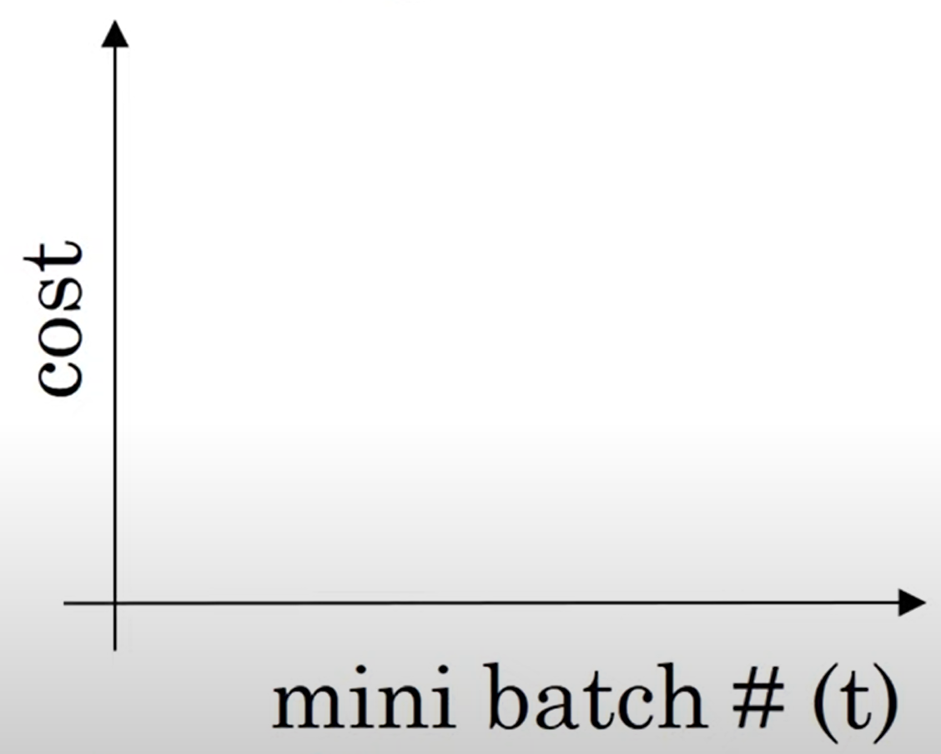
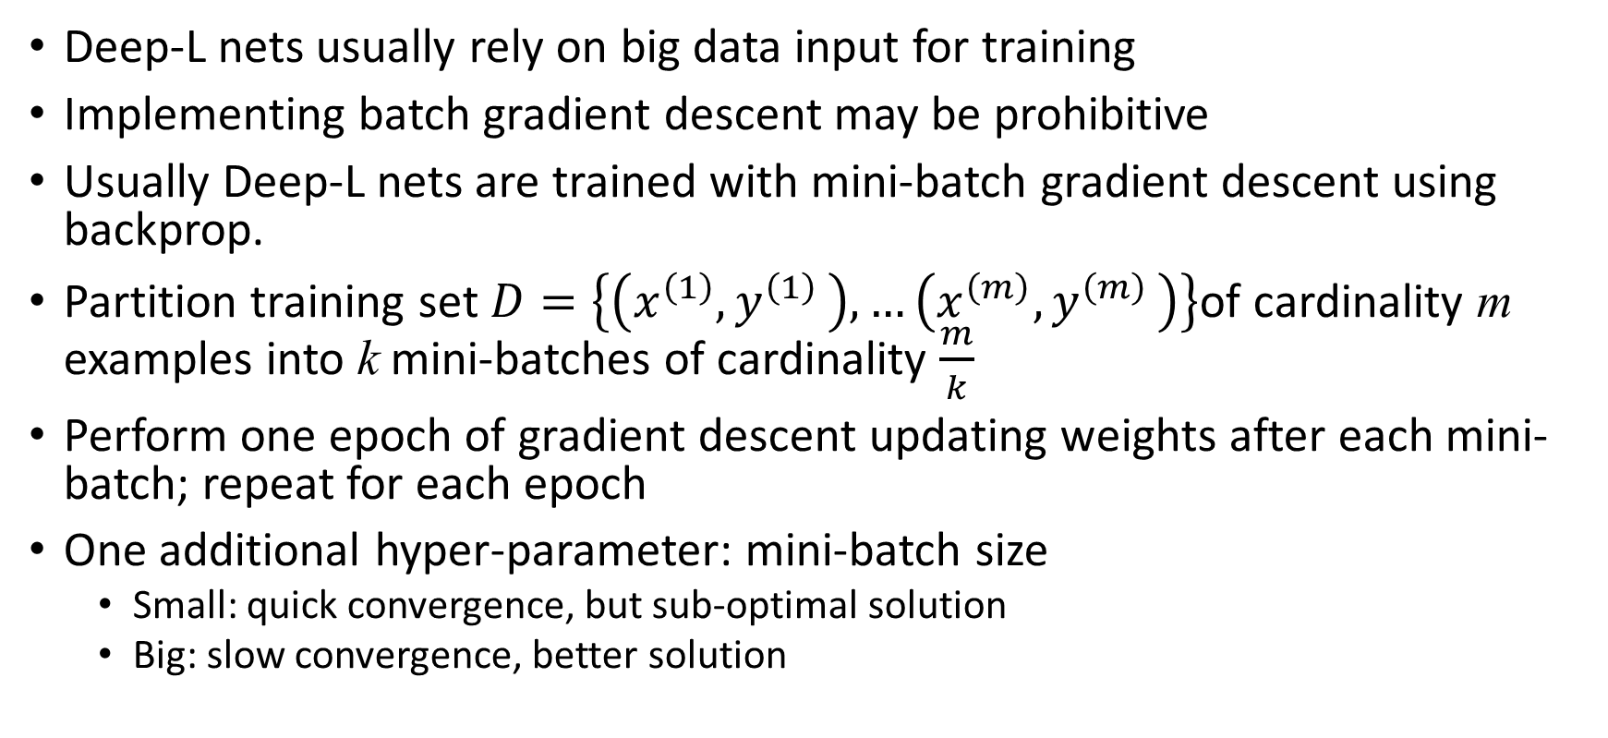
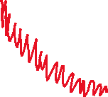
Big Data: mini-batch GD
Deep-L nets usually rely on big data input for training
Implementing batch gradient descent may be prohibitive
Usually Deep-L nets are trained with mini-batch gradient descent using backprop.
Partition training set $D=\left\{\left(x^{\left(1\right)}{,y}^{\left(1\right)}\right), …\left(x^{\left(m\right)}{,y}^{\left(m\right)}\right)\right\}$of cardinality m examples into k mini-batches of cardinality $\frac{m}{k}$
Perform one epoch of gradient descent updating weights after each mini-batch; repeat for each epoch
One additional hyper-parameter: mini-batch size
  Small: quick convergence, but sub-optimal solution
  Big: slow convergence, better solution

Slide 3
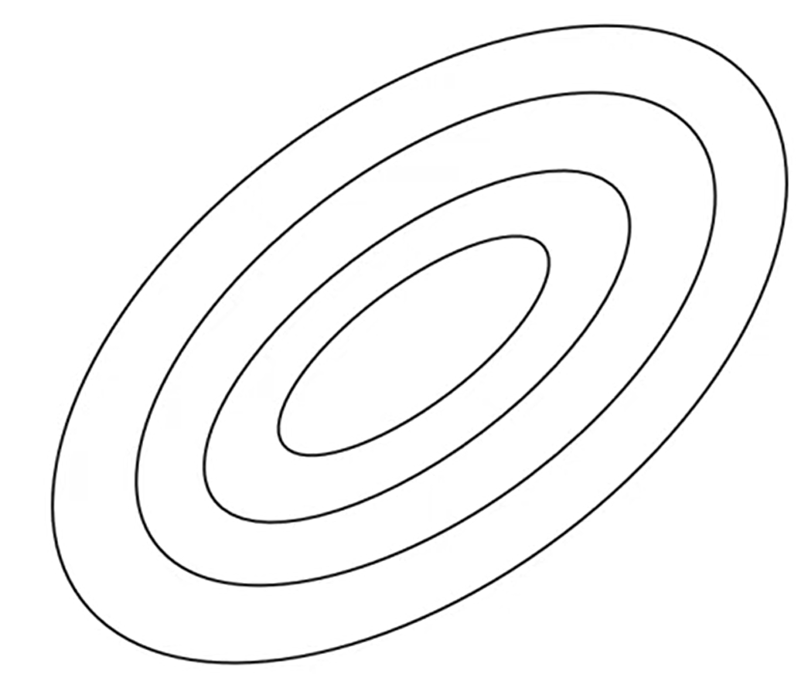

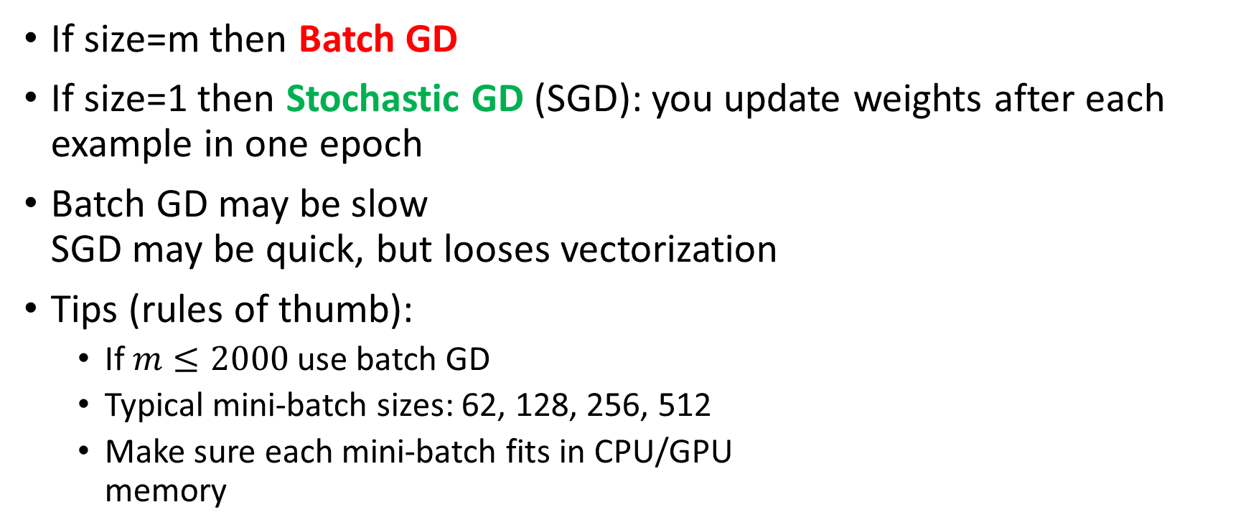

Mini-batch size
If size=m then Batch GD
If size=1 then Stochastic GD (SGD): you update weights after each
example in one epoch
Batch GD may be slow
SGD may be quick, but looses vectorization
Tips (rules of thumb):
  If $m≤2000$ use batch GD
  Typical mini-batch sizes: 62, 128, 256, 512
  Make sure each mini-batch fits in CPU/GPU
  memory

Slide 4
Exponentially weighted averages
A key component of optimization algorithm for deep networks

Slide 5
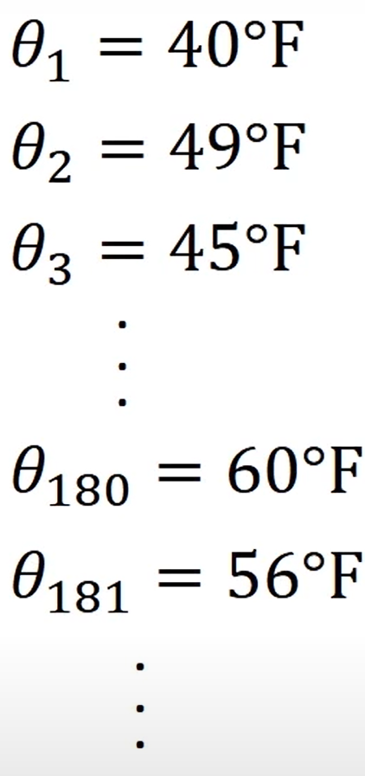
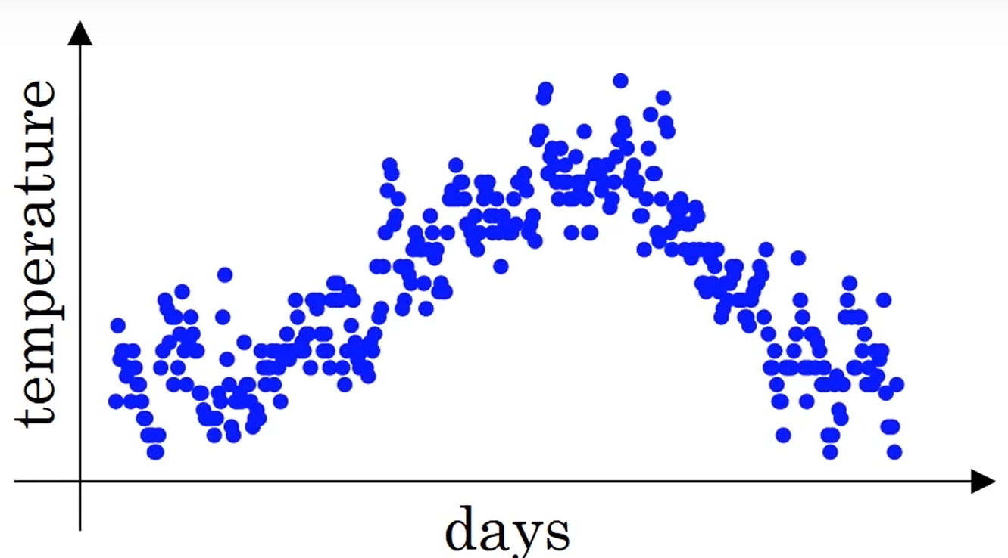
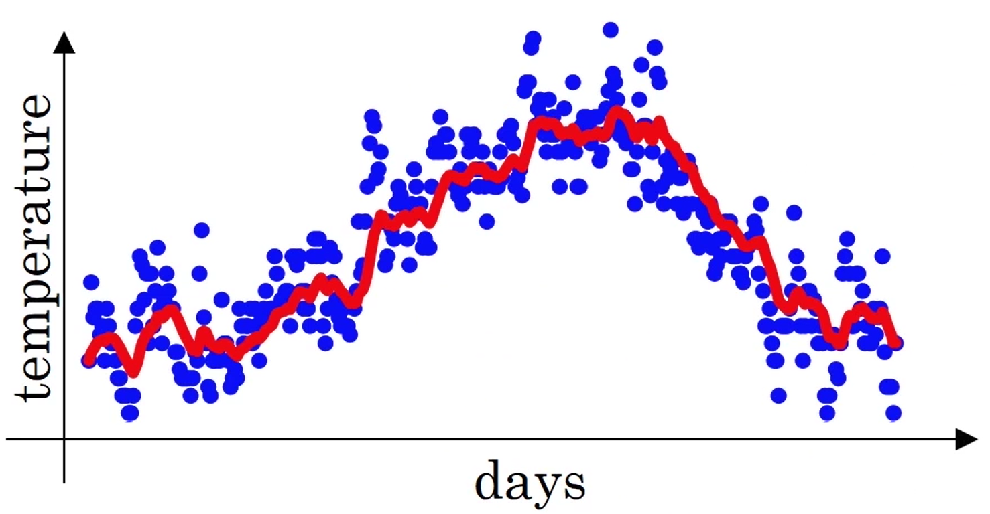
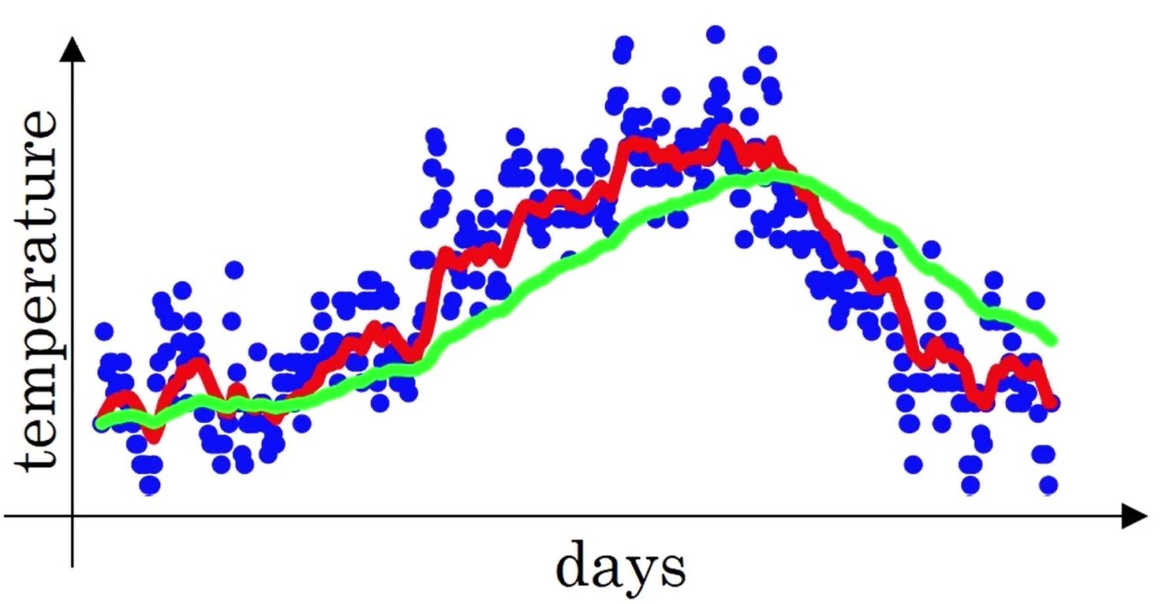
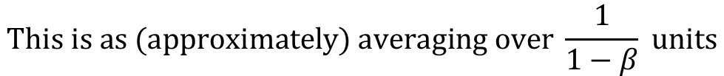

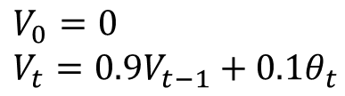
Moving average: exponentially weighted
Averaging over 10 days
(β=0.9)
Averaging over 50 days
(β=0.98)
$$V_{0}=0 \\ V_{t}=0.9V_{t−1}+0.1θ_{t}$$
$$\text{In} \text{general}\text{: }V_{t}=βV_{t−1}+(1−β)θ_{t}$$
$$\text{This} \text{is} \text{as}\text{ (}\text{approximately}\text{) }\text{averaging} \text{over} \frac{1}{1−β} \text{units}$$

Slide 6

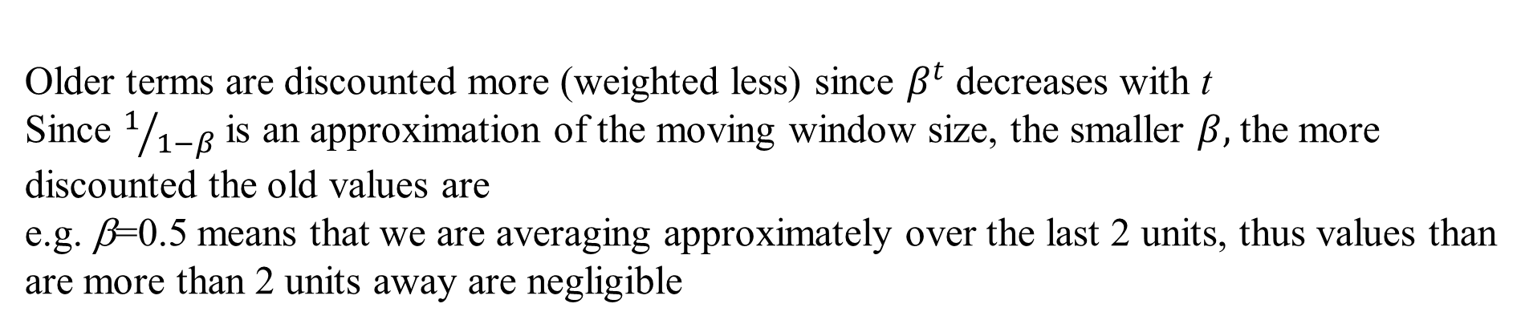
Exponentially weighted averages
$$v_{t}=βv_{t−1}+(1−β)θ_{t}$$
$v_{t}=\left(1−β\right)θ_{t}+\left(1−β\right)βθ_{t−1}+\left(1−β\right)β^{2}θ_{t−2}+(1−β)β^{3}θ_{t−3}$+…
Older terms are discounted more (weighted less) since $β^{t}$ decreases with t
Since $1/{1−β}$ is an approximation of the moving window size, the smaller $β,$the more
discounted the old values are
e.g. β=0.5 means that we are averaging approximately over the last 2 units, thus values than
are more than 2 units away are negligible

Slide 7
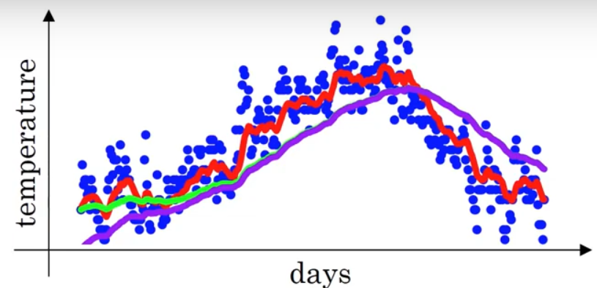
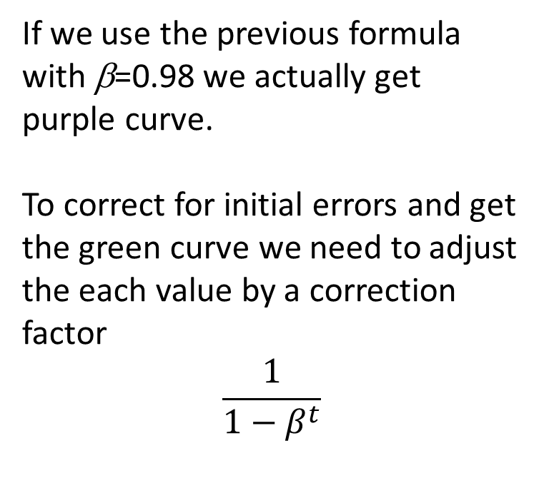
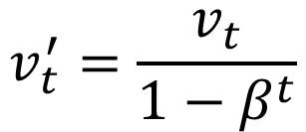
Bias correction
If we use the previous formula
with β=0.98 we actually get
purple curve.
To correct for initial errors and get
the green curve we need to adjust
the each value by a correction
factor
$$\frac{1}{1−β^{t}}$$
$$v_{t}^{′}=\frac{v_{t}}{1−β^{t}}$$
At the beginning the correction normalizes the weighted sum, while
For large t the factor has no influence

Slide 8
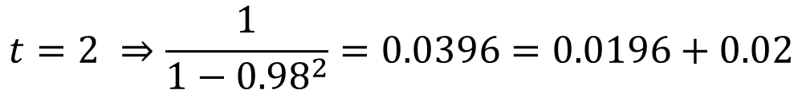
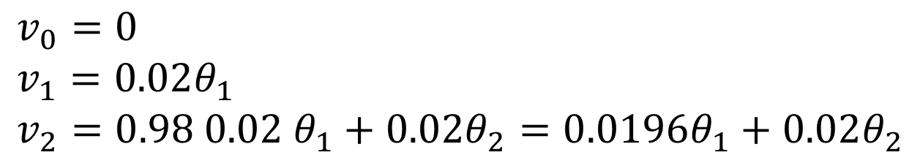
example
$$v_{0}=0 \\ v_{1}=0.02θ_{1} \\ v_{2}=0.98 0.02 θ_{1}+0.02θ_{2}=0.0196θ_{1}+0.02θ_{2}$$
$$t=2 ⇒\frac{1}{1−{0.98}^{2}}=0.0396=0.0196+0.02$$
$$\left(1−β\right)+\left(1−β\right)β+\left(1−β\right)β^{2}+…\left(1−β\right)β^{t}=1−β+β−β^{2}+β^{2}−β^{3}+….−β^{t}=1−β^{t}$$

Slide 9
SMA=simple moving average EMA=exponentially weighted moving average bias corrected

Slide 10
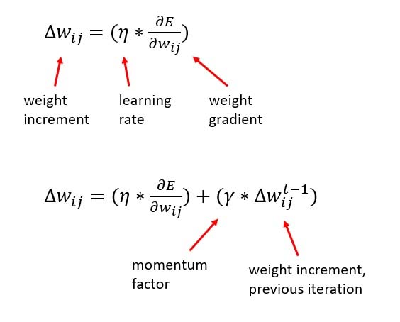
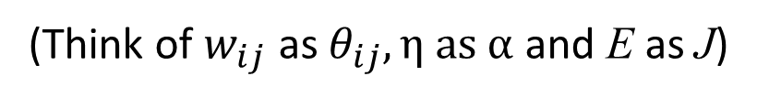

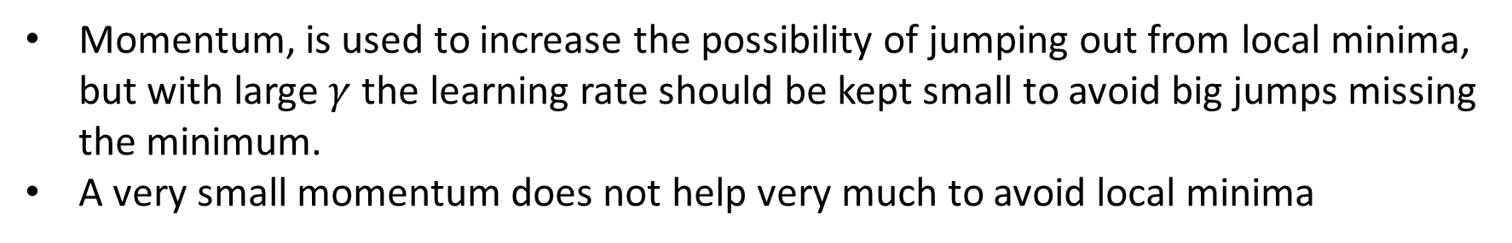
Gradient Descent with Momentum
(Think of $w_{ij}$ as $θ_{ij}, η \text{as} α$and E as J)
$$0≤γ≤1$$
Momentum, is used to increase the possibility of jumping out from local minima, but with large $γ$ the learning rate should be kept small to avoid big jumps missing the minimum.
A very small momentum does not help very much to avoid local minima

Slide 11
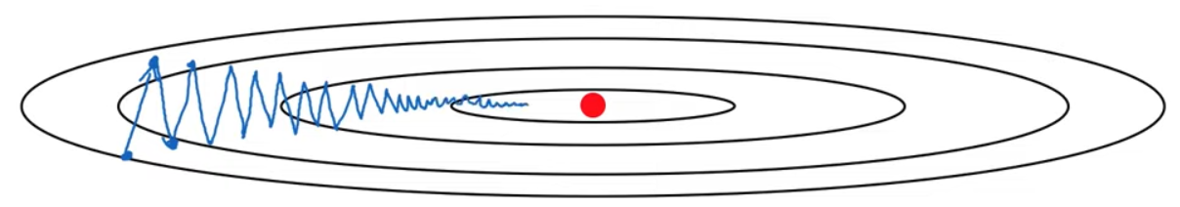

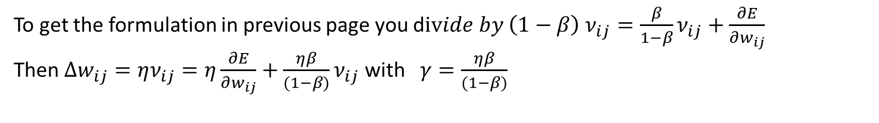
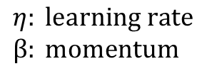
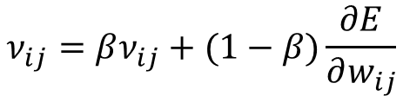
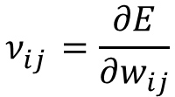
Momentum as a EMA of gradient
$$w_{ij}=w_{ij}−ην_{ij}$$
$$ν_{ij}^{}=\frac{∂E}{∂w_{ij}}$$
Standard gradient descent
$$ν_{ij}=βν_{ij}+(1−β)\frac{∂E}{∂w_{ij}}$$
$$η: \text{learning} \text{rate} \\ β: \text{momentum}$$
EMA of the gradient
Usually no bias correction!
To get the formulation in previous page you d$ivide by \left(1−β\right) ν_{ij}=\frac{β}{1−β}ν_{ij}+\frac{∂E}{∂w_{ij}}$
Then ${Δw}_{ij}=ην_{ij}=η\frac{∂E}{∂w_{ij}}+\frac{ηβ}{(1−β)}ν_{ij}$ with $γ=\frac{ηβ}{(1−β)}$

Slide 12
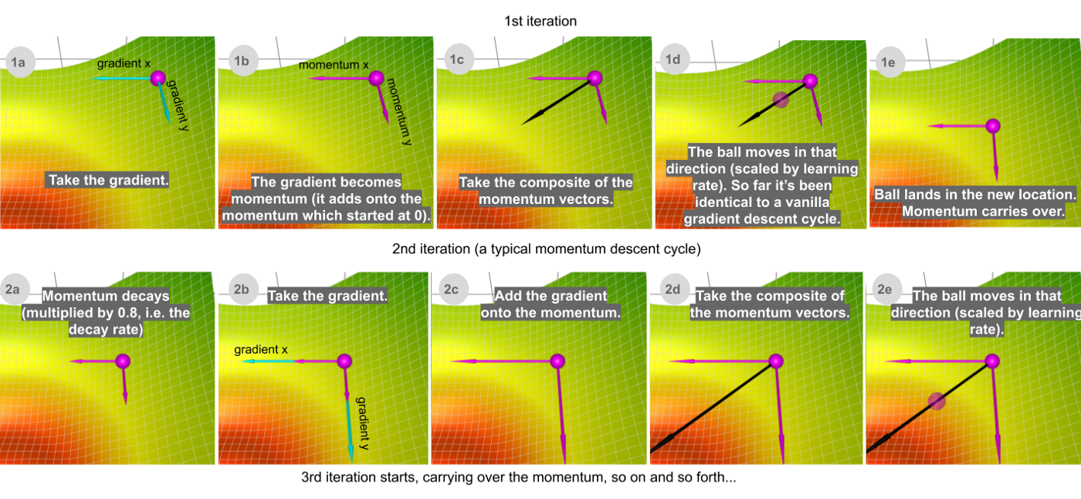

Slide 13
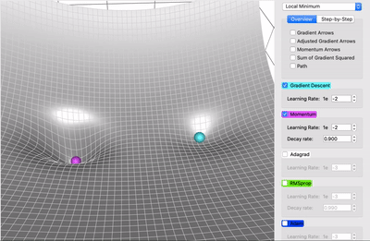
Momentum (magenta) vs. Gradient Descent (cyan) on a surface with a global minimum (the left well)
and local minimum (the right well)

Slide 14



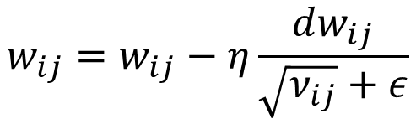
RMSprop (root mean square propagation)
Idea: EMA of the square of the gradient values, then update parameters by dividing by the root square of EMA values
We normalize the effect of fluctuations in derivatives by dividing by the sqrt of the squared EMA (large values becomes smaller and vice-versa small values are increased providing larger steps in those directions)
Curiosity: proposed by G. Hinton in a Coursera lecture and never published
$$\text{Let} dw_{ij}=\frac{∂E}{∂w_{ij}}$$
$$ν_{ij}=βν_{ij}+\left(1−β\right)dw_{ij}^{2}$$
$$w_{ij}=w_{ij}−η\frac{dw_{ij}}{\sqrt{ν_{ij}}+ε}$$
Update rule
$$ε>0 \text{to} \text{avoid} \text{dividing} \text{by} \text{zero}$$

Slide 15
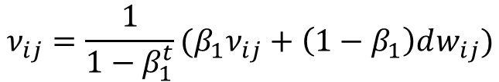

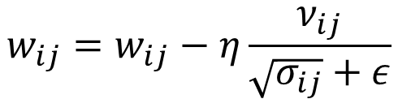
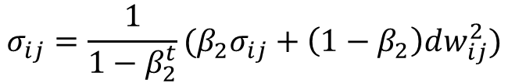
ADAM optimization
It is a combination of Momentum and RMSprop with bias correction
Hyperparameters:
  $\text{learning} \text{rate} η: \text{to} \text{be} \text{tuned}$
  $β_{1}=0.9 \text{(}\text{usual} \text{default}\text{)}$
  $β_{2}=0.999 \text{(}\text{usual} \text{default}\text{)}$
  $ε={10}^{−8}$
$$ν_{ij}={\frac{1}{{1−β}_{1}^{t}}(β}_{1}ν_{ij}+\left(1−β_{1}\right)dw_{ij})$$
$$σ_{ij}=\frac{1}{1−β_{2}^{t}}(β_{2}σ_{ij}+\left(1−β_{2}\right)dw_{ij}^{2})$$
$$w_{ij}=w_{ij}−η\frac{ν_{ij}}{\sqrt{σ_{ij}}+ε}$$
ADAM: ADAptive Momentum

Slide 16
Visualization of RMSProp e Adam
https://towardsdatascience.com/a-visual-explanation-of-gradient-descent-methods-momentum-adagrad-rmsprop-adam-f898b102325c

Slide 17
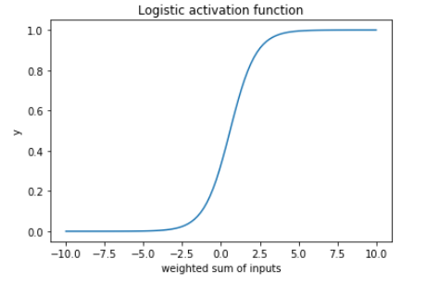
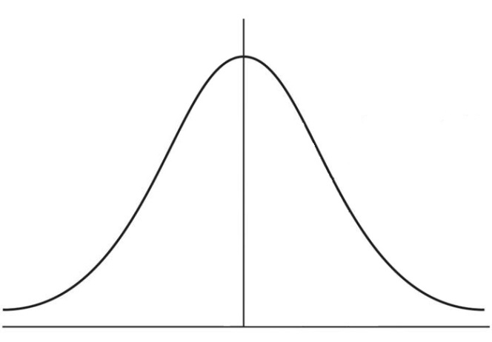
Batch Normalization (BN)
As for input values, we can normalize values at inner nodes as well
Main difference: it is not smart to normalize such values at mean 0 and variance 1
In this range the activation is
almost linear…..

Slide 18
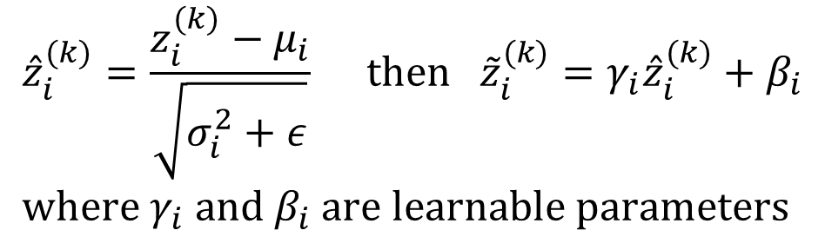

Batch Normalization: details
We compute the mean $μ_{i}$and the variance $σ_{i}^{2}$of the inner nodes $z_{i }$of each layer within every mini-batch (impractical to perform over the whole training set)
For each layer, let $z_{i}^{(k)}$ be the i-th inner node value (before activation) in the k-th mini-batch case
$${\hat{z}}_{i}^{(k)}=\frac{z_{i}^{(k)}−μ_{i}}{\sqrt{σ_{i}^{2}+ε}} \text{then} {\tilde{z}}_{i}^{(k)}=γ_{i}{\hat{z}}_{i}^{(k)}+β_{i} \\ \text{where} γ_{i} \text{and} β_{i} \text{are} \text{learnable} \text{parameters}$$

Slide 19
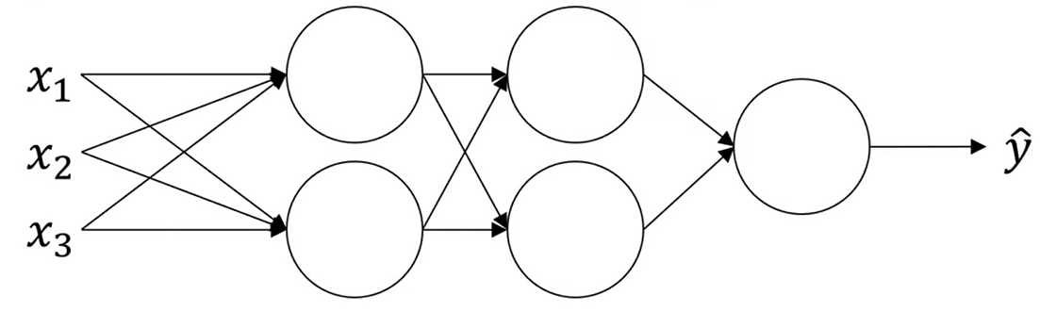















Batch Normalization: learning
Layer 1
Layer 2
Layer 3
$$z_{1}^{[2]}$$
$$a_{1}^{[2]}$$
$$z_{1}^{[3]}$$
$$a_{1}^{[3]}$$
$$Θ^{[1]}$$
$$Θ^{[2]}$$
$$z_{2}^{[2]}$$
$$a_{2}^{[2]}$$
$$z_{2}^{[3]}$$
$$a_{2}^{[3]}$$
For each mini-batch: grad desc on learnable parameters (fp=forw prop; bn= batch norm; act= activation)
fp
bn
act
fp
bn
$x ⟶{ z}^{\left[2\right]} ⟶ {\tilde{z}}^{\left[2\right]} ⟶ a^{\left[2\right]} ⟶ z^{\left[3\right]} ⟶ {\tilde{z}}^{\left[3\right]} ⟶$…
$$Θ^{[1]}$$
$$φ()$$
$$Θ^{[2]}$$
$$γ^{[1]},β^{[1]}$$
$$γ^{[2]},β^{[2]}$$
In practice it is like adding a BN layer after a layer to be normalized and performing standard backprop to learn $Θ, γ,β$
Technicality: mean normalization gets rid of the bias term, thus when using BN there is non need for bias units.

Slide 20
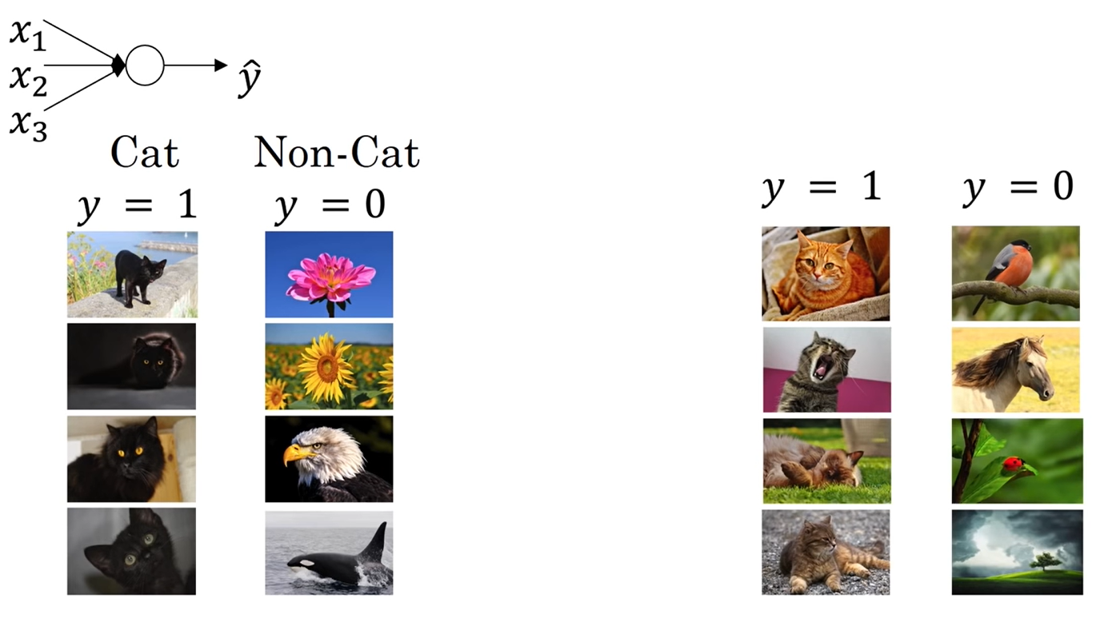
Covariate shift (learning on shifting input distributions)
If the actual classification boundary is the green one
it is hard that one is able to learn it with just the training
set on the left or on the right (shift in the input distribution
will influence the result)
Only black cats
Colored cats
X
X
X
X
X
X
X
X
X
O
O
O
O
O
O
O
O
O
O
O
O

Slide 21
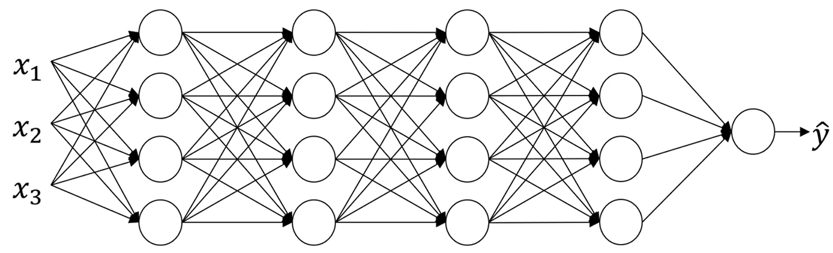
Covariate shift: if you train a model to learn a mapping from input to output, by changing the input distribution you have to re-train your model, even if the ground true mapping between input and output does not change.
Why this affect D-NN?
If we consider a deep layer in the net (e.g. layer 4), its input values depends on the previous weights
that may be a large number (e.g. input to layer 3 depends on weights at layers 1,2 and 3);
this means that the input to the layer may change a lot (i.e., from the perspective of the layer, its inputs
suffer of distribution shift)
BN takes this shift under control, since even if values change, they keep same mean and same variance
Moreover, since mean and variance are computed within mini-batches, this introduces a small noise
in the hidden unit values which has the effect of a regularization (smaller the mini-batch size, larger is the
regularization effect)

Slide 22
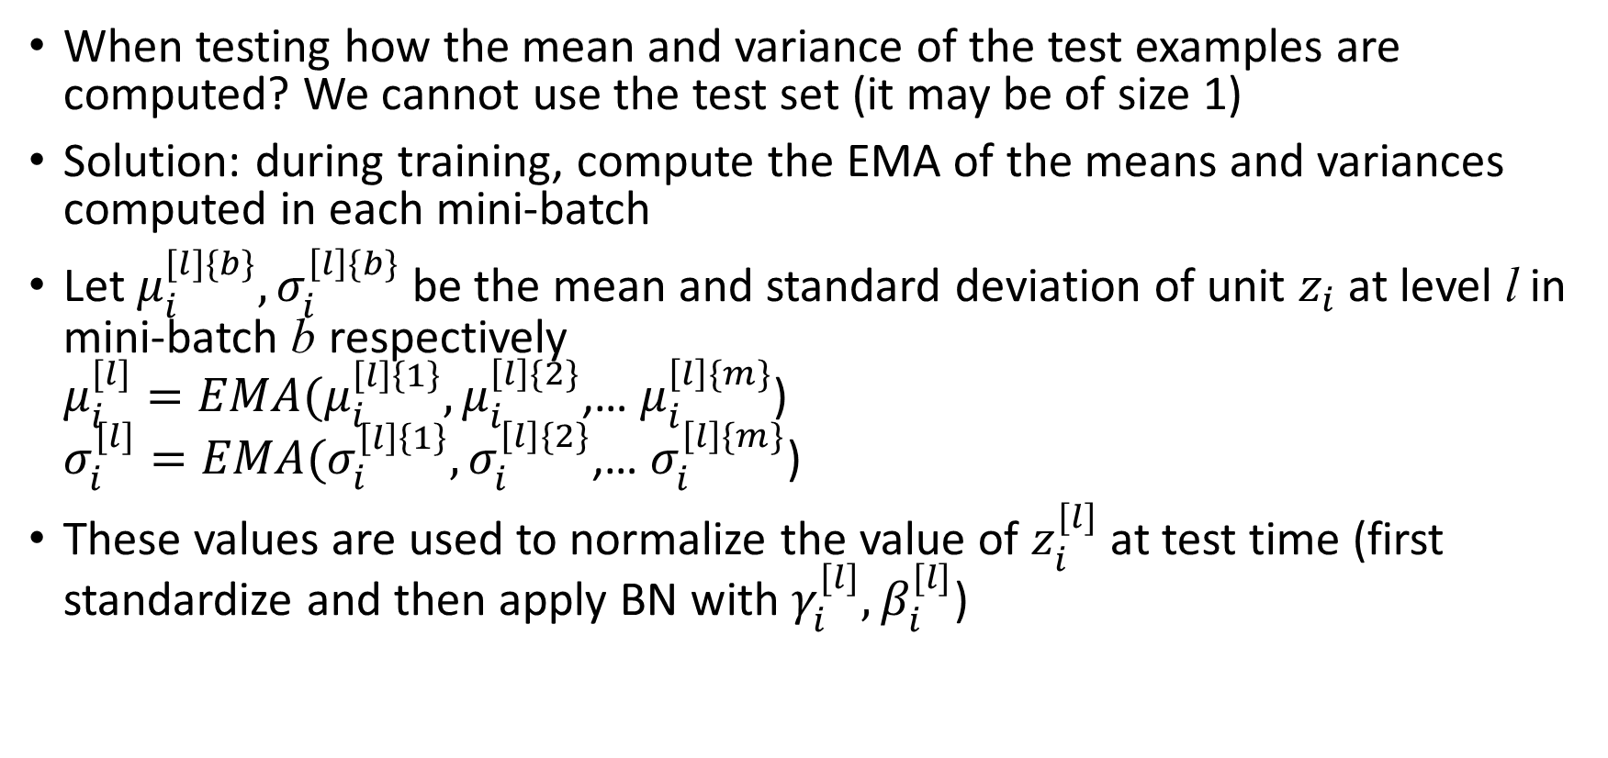
BN at test time
When testing how the mean and variance of the test examples are computed? We cannot use the test set (it may be of size 1)
Solution: during training, compute the EMA of the means and variances computed in each mini-batch
Let $μ_{i}^{[l]\{b\}}, σ_{i}^{\left[l\right]\{b\}}$ be the mean and standard deviation of unit $z_{i}$ at level l in mini-batch b respectively
$μ_{i}^{[l]}=EMA(μ_{i}^{\left[l\right]\left\{1\right\}},μ_{i}^{\left[l\right]\{2\}}$,… $μ_{i}^{\left[l\right]\{m\}}$)
$σ_{i}^{[l]}=EMA(σ_{i}^{\left[l\right]\left\{1\right\}},σ_{i}^{\left[l\right]\{2\}}$,… $σ_{i}^{\left[l\right]\{m\}}$)
These values are used to normalize the value of $z_{i}^{[l]}$ at test time (first standardize and then apply BN with $γ_{i}^{[l]},β_{i}^{[l]}$)

